Slide 1

Enhancing The Efficacy Of
Cancer Immunotherapy
Non-Confidential Overview
January 2016

Slide 2
Enhancing The Efficacy Of
Cancer Immunotherapy
Non-Confidential Overview
January 2016

Slide 3
Enhancing The Efficacy Of
Cancer Immunotherapy
Non-Confidential Overview
January 2016

Slide 4
Outline
Corporate Overview
Executive Summary, Leadership
Cancer Immunotherapy
Unmet Need, Checkpoint Inhibitors
Scientific Rationale
Toll-Like Receptors and CpGs
Checkmate Approach
CMP-001, Path to POC
Summary

Slide 5
Checkmate: Executive Summary
Mission: Increase efficacy of cancer immunotherapy
Thesis: Increase response rate and duration to anti-PD-1/PD-L1 through converting non-responder “cold” tumors to “hot” tumors with a TLR9 agonist
Company: Virtual company formed in 2015, experienced team
Lead Program: CMP-001 is best-in-class CpG DNA/Toll-like receptor 9 (TLR9) agonist; has shown human safety, Th1 activity, in >700 subjects; expect phase 1b melanoma POC data during 2016
Funding: Secured $20M Series A (Sofinnova, venBio) in August 2015
Patents: Issued IP on lead program; broad IP filed on novel combinations (CpG + checkpoint inhibitors), various CpG designs
Opportunity: CMP-001 combo with checkpoint inhibitors across oncology, 2nd generation CpGs

Slide 6














Experienced Leadership Team and Board
Art Krieg | CEO
Bill Slichenmyer | Clinical
Chuck Abdalian | CFO
Cindy Berman | Preclin. Safety
Norm Greenberg | SVP Transl. Med.
Frank Hennecke | EVP Drug Devt.
Ramani Varanasi | CBO
Chuck Yon | GC
Mike Powell | Chairman (Board) | General Partner, Sofinnova
Corey Goodman | Director (Board) | Partner, venBio

Slide 7
The Evolution of Cancer Immunotherapy
1890’s – Coley’s toxin (bacterial extracts, now known to be immune stimulatory; worked initially, but unreliable, no QC)
1970’s to 1980’s – nonspecific immune activators (failed)
1990’s – induce anti-tumor T cells (IL-2, cancer vaccines; almost always failed)
2000’s – deliver large numbers of ex vivo-activated T cells (e.g., CAR-T; sometimes works, but toxic, complex, and very expensive)
mid 2000’s – fundamental strategic shift from activating immunity to taking off the immune brakes: start of the era of checkpoint inhibition
2011 – first checkpoint inhibitor approved: ipilimumab (Yervoy; anti-CTLA-4; quite toxic, but ~20% of advanced cancer patients respond)
2014 – two anti-PD-1 checkpoint inhibitors approved (Opdivo, Keytruda); much safer than ipi, but still only ~20% response rate in most cancers
Current challenge: How to improve ORR to anti-PD1?

Slide 8
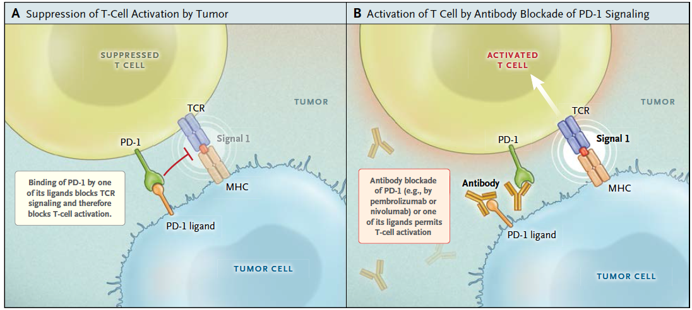
Anti-PD-1 Works Great In “Hot” Tumors With TIL How to convert the other ~80% of patients to responders?
Anti-PD-1 simply “releases the brakes” on the immune system
Strong scientific rationale to combine anti-PD-1 with an immune activator, but which one would be best?
Most effective PD-1 combo should be with a strong CTL inducer
TLR9 agonists are the strongest known CTL inducers in humans
Ribas, NEJM 2015

Slide 9
Toll-Like Receptors (TLR) Recognize Pathogen-Expressed Molecules
Bacterial lipopeptides
GPI-anchored proteins (parasites)
Lipoteichoic acid (gram + bacteria)
zymosan (fungi)
LPS (gram - bacteria)
Flagellin (motile bacteria)
2
2
6
4
4
2
5
1
2
CELL MEMBRANE
7
8
3
9
dsRNA
(viruses)
ssRNA
(viruses)
CpG DNA
(bacterial and viral DNA)
ENDOSOME

Slide 10
TLR9 Agonists (CpG oligos) Induce The Strongest Type I IFN and CTL Response
Bacterial lipopeptides
GPI-anchored proteins (parasites)
Lipoteichoic acid (gram + bacteria)
zymosan (fungi)
LPS (gram - bacteria)
Flagellin (motile bacteria)
2
2
6
4
4
2
5
1
2
CELL MEMBRANE
7
8
3
9
dsRNA
(viruses)
ssRNA
(viruses)
CpG DNA
(bacterial and viral DNA)
ENDOSOME

Slide 11
How Can TLR9 Activation Work in Treating Cancer?
In Vivo Activation of Dendritic Cells
Activation of anti-tumor Th1-like innate immune responses
Type I IFN, chemokines and cytokines
Cell based; NK cells, DC, monocytes/macrophages
Converts “cold” tumor to “hot”
Activation of tumor-specific Th1 adaptive immunity
CpG activates pDC, mDC in tumor and DLN
Mature pDC and mDC present tumor antigens; induce tumor-specific CTL in nearly all cancer patients
TLR9 agonists induce stronger CTL responses in cancer vaccine studies than any other immune activator

Slide 12
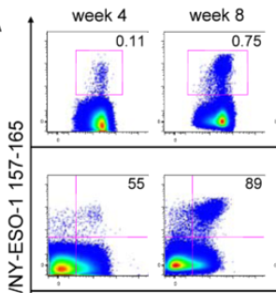
TLR9 ligands Induce Anti-tumor CD8⁺ T cells
% tumor-specific CD8⁺ T cells
Rapid expansion of anti-tumor cytolytic T cells
A2/NY-ESO-1 peptide
CD8
12 HLA-A2⁺ patients with stage III/IV NY/ESO-1⁺ melanoma were vaccinated with 2mg CpG-B + 400-800 ug NY-ESO-1 peptides in Montanide biweekly X 8 (4 mos). PBMC were collected at indicated timepoints, and gated on CD8⁺ T cells.
Fourcade et al., Cancer Res, 74:1045, 2014.

Slide 13
TLR9 ligands Induce Anti-tumor CD8⁺ T cells BUT Also Induce PD-1; “Setting The Immune Brakes”
% tumor-specific CD8⁺ T cells
Rapid expansion of anti-tumor cytolytic T cells
A2/NY-ESO-1 peptide
Expression of PD-1 brake prevents function: predicts synergy for PD-1 combo
PD-1⁺ CD8⁺ T cells
PD-1
12 HLA-A2⁺ patients with stage III/IV NY/ESO-1⁺ melanoma were vaccinated with 2mg CpG-B + 400-800 ug NY-ESO-1 peptides in Montanide biweekly X 8 (4 mos). PBMC were collected at indicated timepoints, gated on CD8⁺ T cells, and examined for PD-1 expression.
Fourcade et al., Cancer Res, 74:1045, 2014.

Slide 14
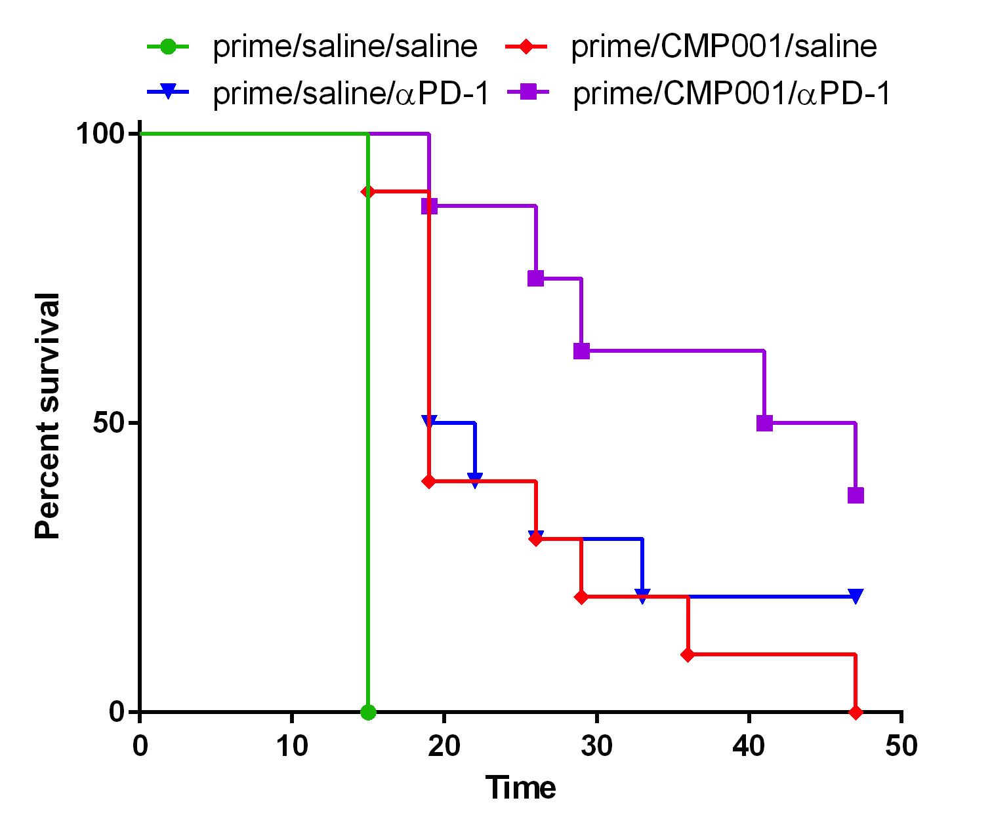
Survival Benefit of Anti-PD-1 + CpG Combo Confirmed In Syngeneic A20 Lymphoma Model
Saline
αPD-1
CMP-001 (D7, 12, 15)
αPD-1 + CMP
Tumors implanted in both flanks on D0
CMP (100 μg) given IT d7, 12, 15 in one side
αPD-1 given IP D7 and then weekly
Conclusion: improved survival with combination of systemic αPD-1 + IT CMP into one of the two tumors
University of Iowa Cancer Center, unpublished data

Slide 15
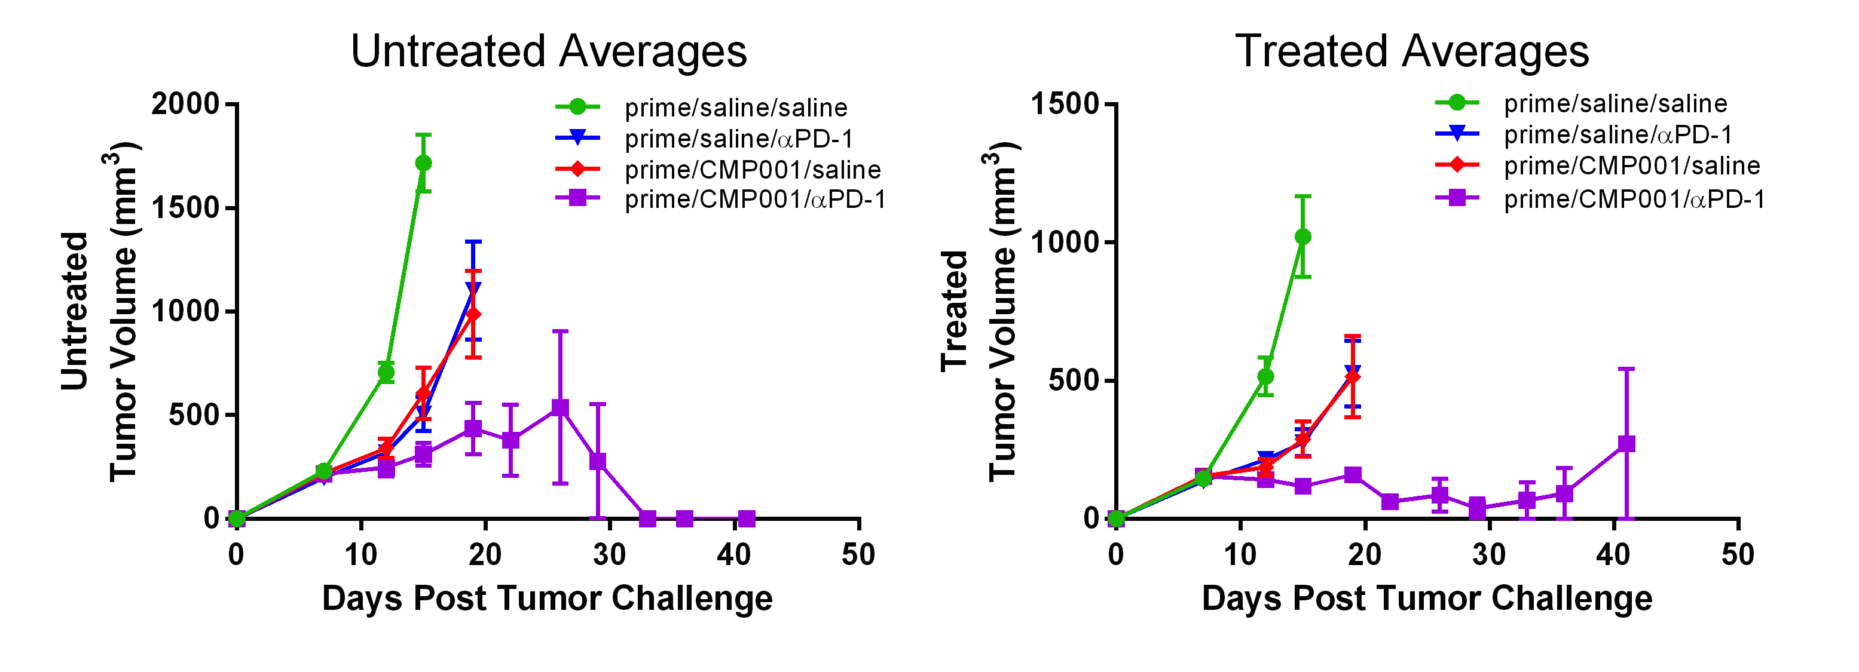
Anti-PD-1 + CpG Combo Controls Growth of Untreated and Treated Tumors
Saline
αPD-1
CMP-001
αPD-1 + CMP
Saline
αPD-1
CMP-001
αPD-1 + CMP
Data plotted until >50% of mice dead in each group
CMP and anti-PD-1 are each effective at control of treated and distant tumor
Approx. additive effect of the combo therapy on treated and distant tumor
University of Iowa Cancer Center, unpublished data

Slide 16
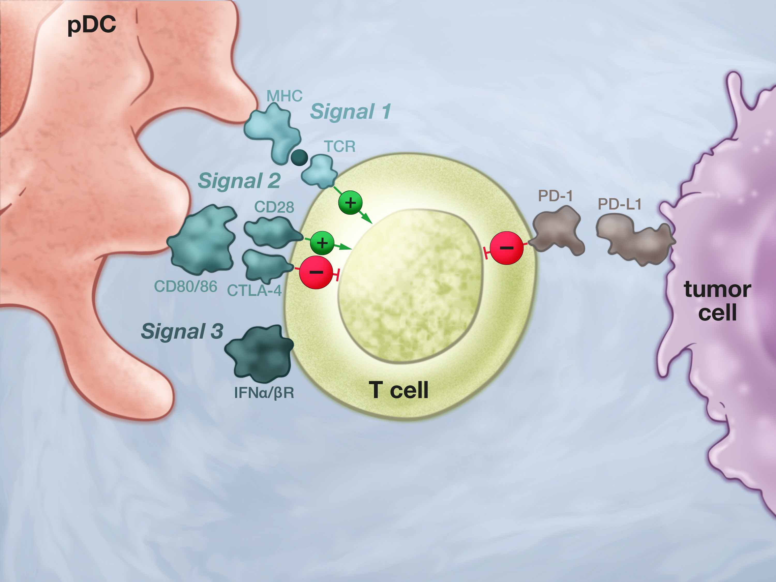
The 3 Signal Model of T Cell Activation Tumor Microenvironment Suppresses T cells

Slide 17
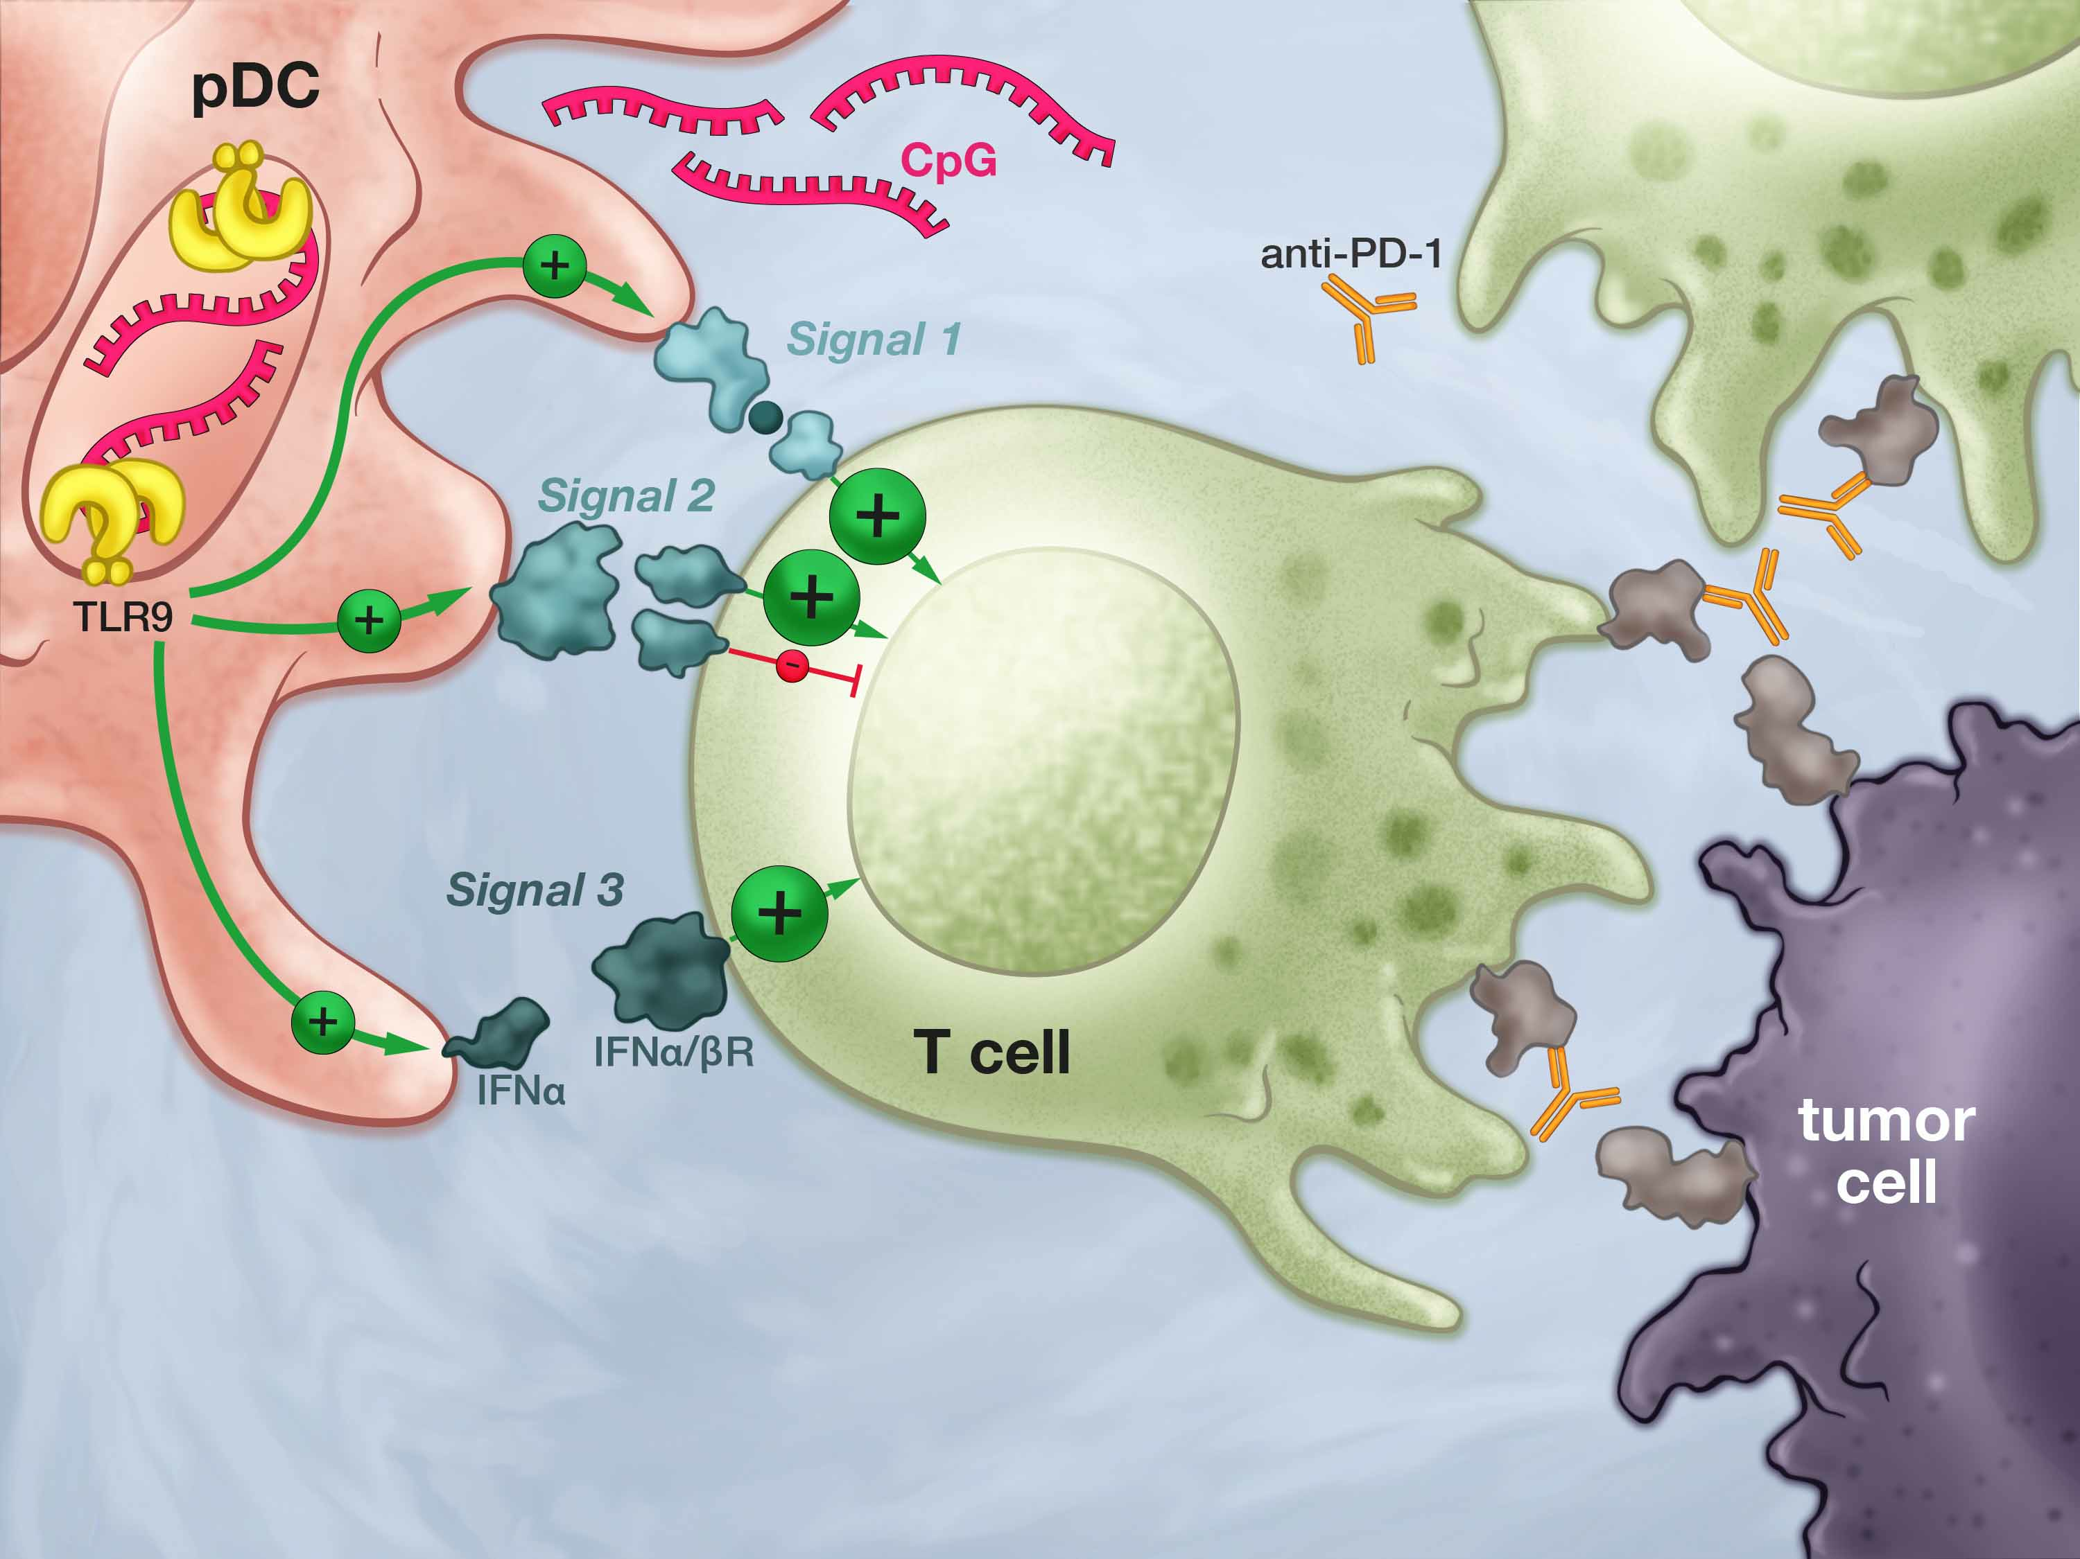
CMP-001 Activates All 3 Signals Synergy with Anti-PD-1

Slide 18
CMP-001 Activates All 3 Signals Synergy with Anti-PD-1
CpG is strongest Th1-inducer of all immune activators
Strongest CTL response in human cancer vaccine trials
Only systemic activator for plasmacytoid DC (pDC)

Slide 19
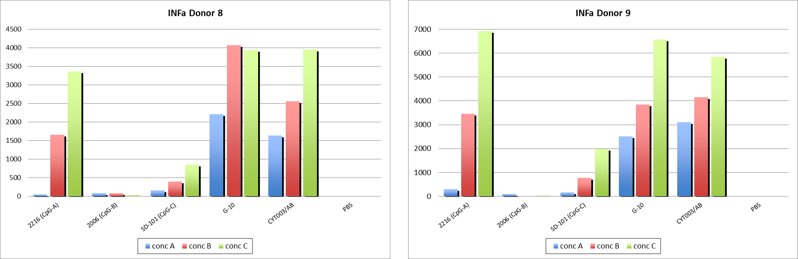
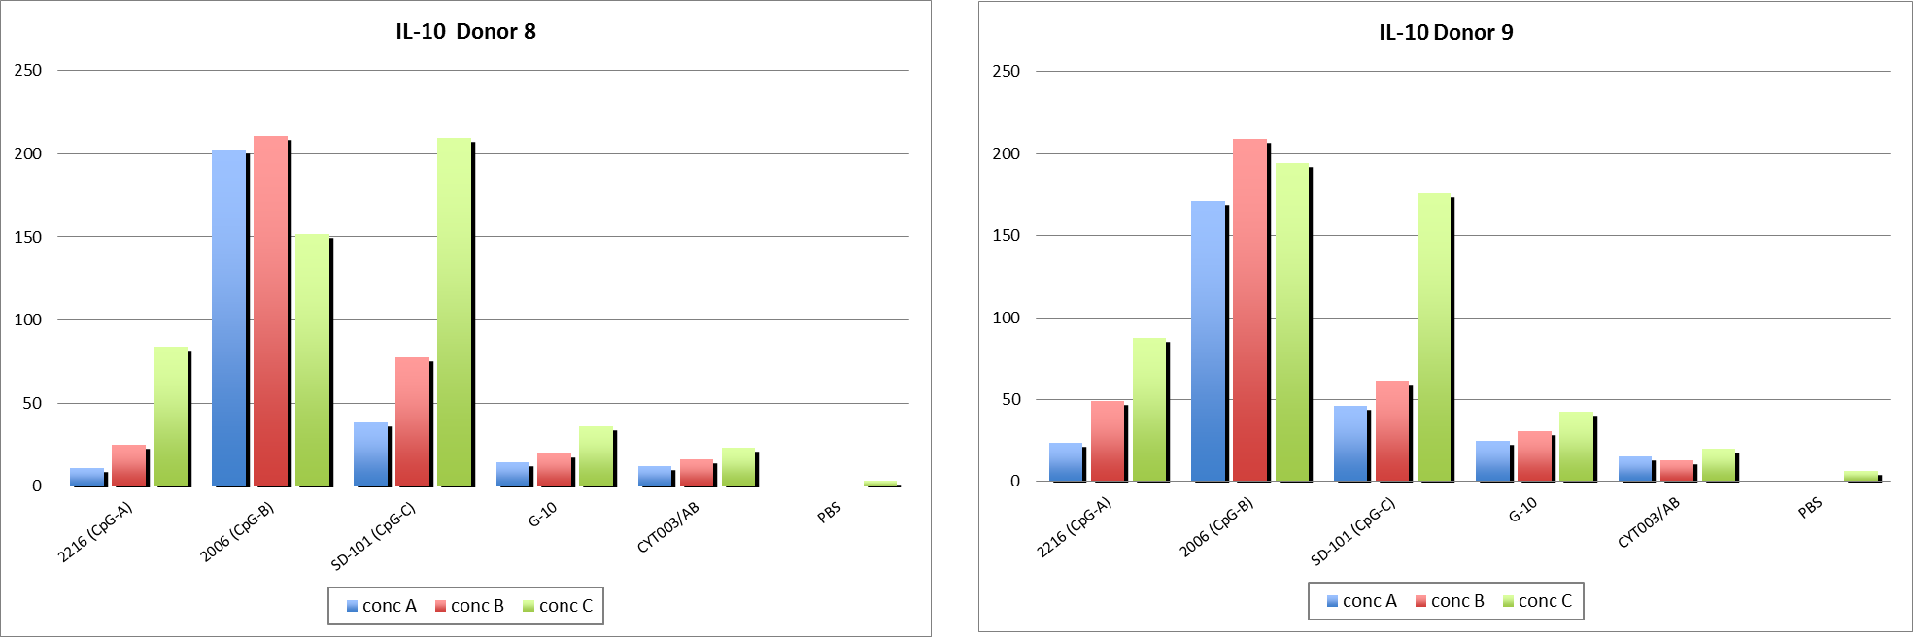
Checkmate CpG-A (CMP-001) Induces Highest IFN-a (Good) and Lowest IL-10 (Bad)
IFN-a
IL-10
CpG-A
CpG-B
CpG-C
(DVAX)
G10
CMP
PBS
CpG-A
CpG-B
CpG-C
(DVAX)
G10
CMP
PBS
Dose-response of human PBMC cultured for 48 hr with the gold standard CpG-A (2216), CpG-B (7909), Dynavax CpG-C (SD-101), Checkmate CpG-A (G10) or CMP-001

Slide 20
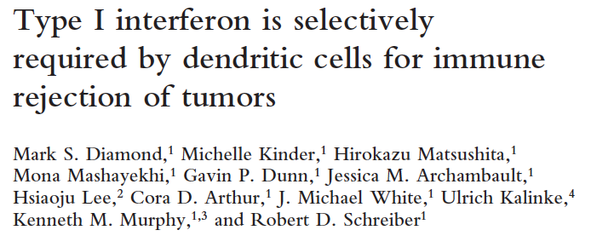
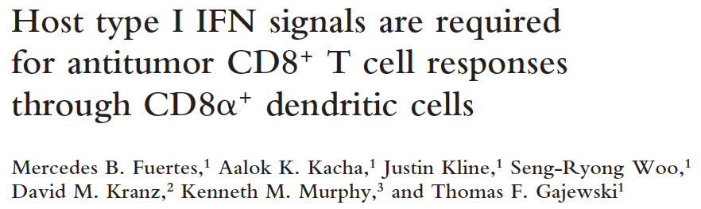
Key Role of IFN-a In Tumor Rejection
Type I IFN:
Augments CD8⁺ T cell survival, expansion, and effector differentiation
Promotes DC maturation, cross-presentation of TAA to CD8⁺ T cells
Required for immune surveillance against carcinogen-induced tumors
Required for rejection of implanted tumors
Levels of IFN-related mRNA correlate with TILs in human metastases
J Exp Med, 2011

Slide 21
TLR9 Ligands and IFN-a
TLR9 ligands do more than “just” induce higher levels of type I IFN than anything else:
Activate pDC and induce secretion of hundreds of other Th1-promoting genes and factors
Convert pDC from immature/tolerance-promoting to mature, activated, CTL-inducing
Recombinant IFN-a does NOT substitute for CpG-A

Slide 22
CMP-001: Checkmate Lead Program
In-licensed clinical asset:
Human safety, immune activity shown in >700 patients
Efficacy as cancer vaccine adjuvant in 49 melanoma patients
Open IND, GMP drug in hand
Jan. ‘16: FPI Phase 1b trial of CMP-001 + pembrolizumab in pembro failures, nonresponders
July – Dec. ’16: clinical data including PD, ORR, discussions with potential partners
Checkmate is interested in exploring clinical collaborations to evaluate CMP-001 combo with αPD-1/L1 in other tumors

Slide 23
Summary: Checkmate’s Approach Enhancing Efficacy of Checkpoint Inhibitors
Convert “cold” αPD-1/L1-refractory tumors to “hot”, responsive tumors through TLR9 with the strongest known Th1/type I IFN inducer, CpG-A
CpG-A avoids immune suppressive IL-10 response to CpG-B and CpG-C
Combo therapy induces systemic tumor-specific adaptive immunity and regression
Improving ORR to partially effective PD-1 therapy provides straightforward pathway to clinical POC

Slide 24
Back-up

Slide 25
To Improve Cancer Immunotherapy, We Need To Generate Many Effector Anti-tumor CD8⁺ T cells
CAR-T cells
Patient-specific therapy
Extremely expensive
Takes months to grow T cells for 1 patient
Checkmate approach
Universal immune activator (Toll-like receptor 9; TLR9) for all patients and ~all cancer types
Synthetic oligonucleotide mimic of viral DNA, low COGs
Natural pathway, excellent TLR9 safety in >6,000 pts, up to 3 yr
TLR9 is strongest known pathway to induce CD8⁺ T cells in humans
Single agent efficacy of TLR9 in oncology already established

Slide 26
Three Distinct CpG Oligo Structures
CpG-A: CYT003 / CMP-001
CpG-B: 2006 / PF-3512676 (former Coley/Pfizer program)
CpG-C: SD-101 (DVAX; Idera also developing a CpG-C)
CpG-A G-quadruplexes determine cell localization and signaling:
CpG-A to early endosomes; CpG-B to late endosomes
CpG-A primarily activate IRF7; CpG-B, C activate NF-kB

